Slide 1
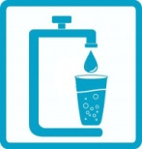
cWater
Joseph Weate
SEAS ‘16
Notes:
Title page… Introduce myself and the name of the product.

Slide 2
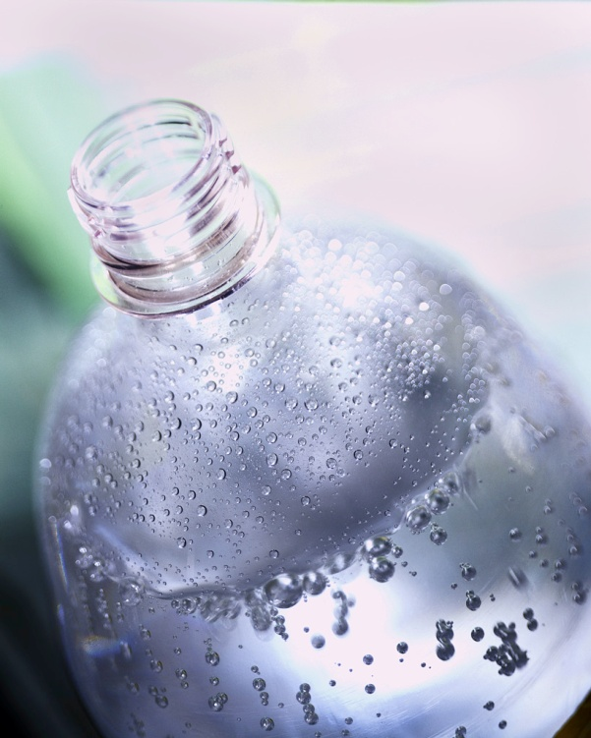
cWater
Portable
Self-use
Potable Water

Slide 3
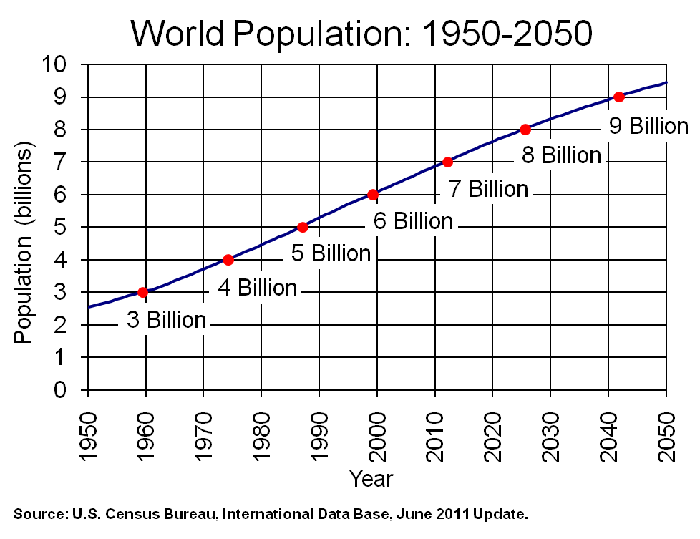
Additional 2 billion people by 2050
Notes:
Already 1.1 billion people don’t have access to clean water
Lower classes who don’t have direct access have to pay 5 to 10 times as much as those with access to receive the same amount of water.

Slide 4
The problem?
Ocean 96.5%
Ground 1%
Fresh 2.5%
Notes:
State the problem and why there is a demand for the product. While 71% of Earth is water, only 3.5% of this water is potable.
**Whats being done**

Slide 5
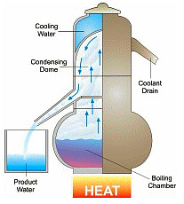
What’s being done:
Thermal Desalination

Slide 6
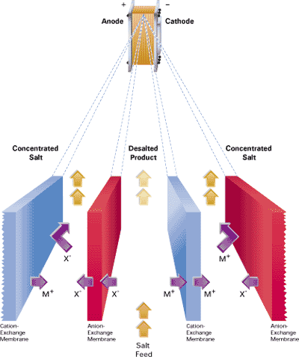
What’s being done:
Electro-dialysis

Slide 7
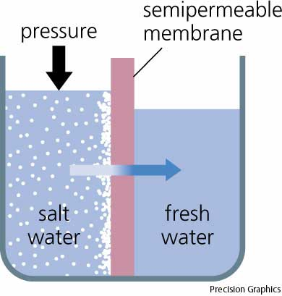
What’s being done:
Reverse Osmosis

Slide 8
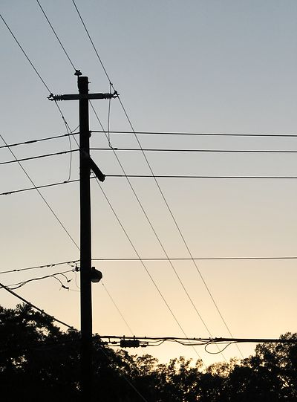
Desalination Plants:
Cost
Energy
Large Scale
Low profit

Slide 9
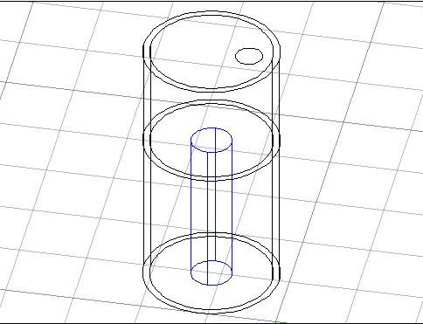
Design:
Two Chambers
Semi-permeable

Slide 10
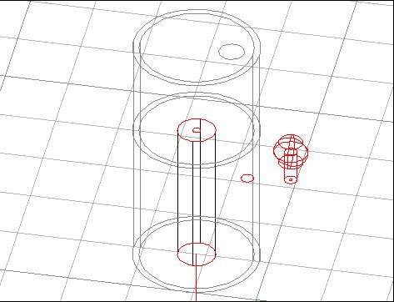
Design:
Air pressure
Empty membrane

Slide 11
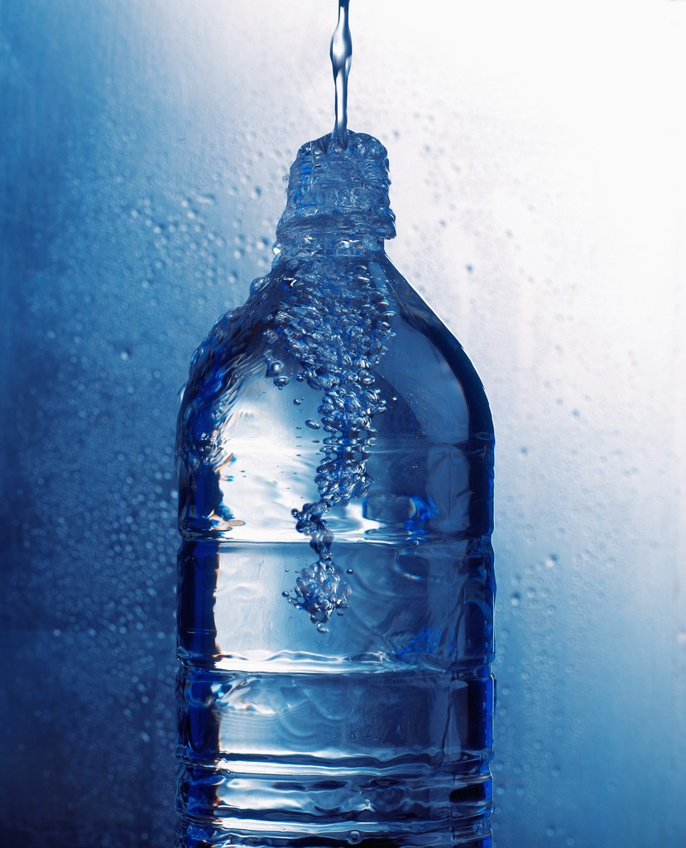
Benefits:
Small Scale
Portable
Personal Use
Cheap
No extensive energy

Slide 12

Market:
Third world countries
Ocean bordering countries
Vessels
Military
Hikers/Campers

Slide 13
Market Value:
Lifesaver Bottle: $76 million agreement
Fresh Water
Salt Water
Lifesaver
cWater

Slide 14
Q&A
cWater
Joseph Weate
SEAS ’16
jfw6fp@virginia.edu
Notes:
Title page… Introduce myself and the name of the product.

Slide 15
Sources
Blue water icon taken from http://www.123rf.com/photo_12340455_blue-icon-with-image-glass-and-tap-water-with-drop.html
World population information and chart from www.census.gov
Water scarcity information from http://seeyourimpact.org/tag/clean-water/
Water desalination techniques from http://geography.about.com/od/waterandice/a/Water-Desalination.htm and http://www.infoplease.com/encyclopedia/science/water-desalination-of.html
Page 6 image from http://www.ameridia.com/html/elep.html
Page 7 image from http://science.yourdictionary.com/reverse-osmosis
MIT research and osmosis picture from http://web.mit.edu/newsoffice/2012/graphene-water-desalination-0702.html
Lifesaver Bottle information from http://www.lifesaversystems.com/

